Slide 1
Segment and Animation

Slide 2
Graphical output can be stored in segments during the execution of a program and later reused. Segments have a number of segment attributes associated with them which allow the user to modify the appearance of the whole segment in a significant way when it is reused.

Slide 3
Consider a animation system in which the user constructs a scenic background and then displays an object moving across the scene on successive frames; the initial frame might be something like Figure

Slide 4
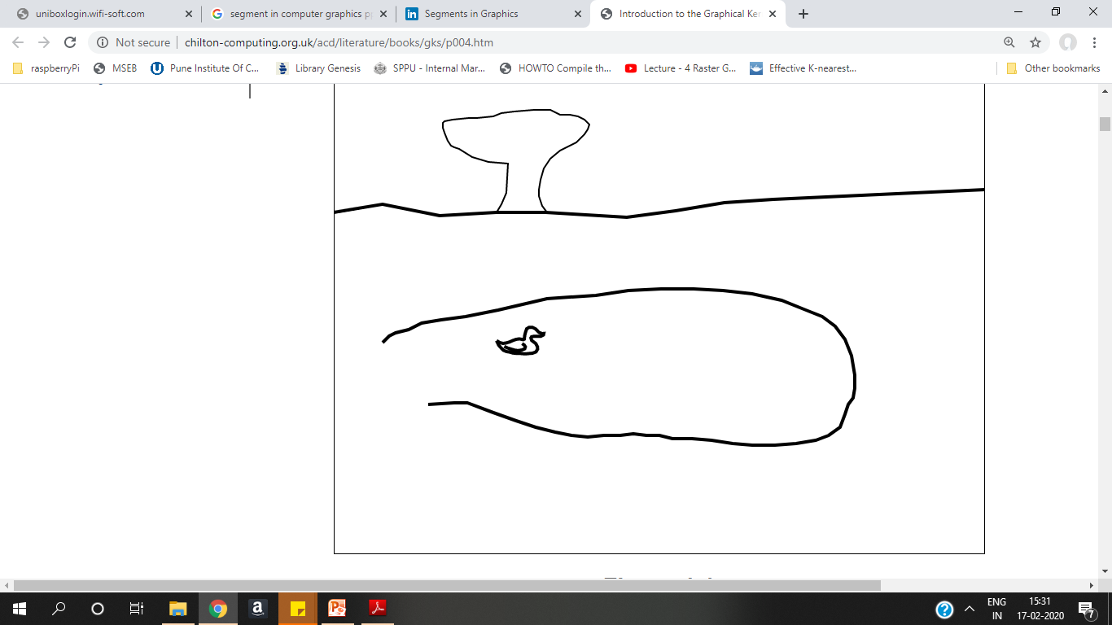

Slide 5
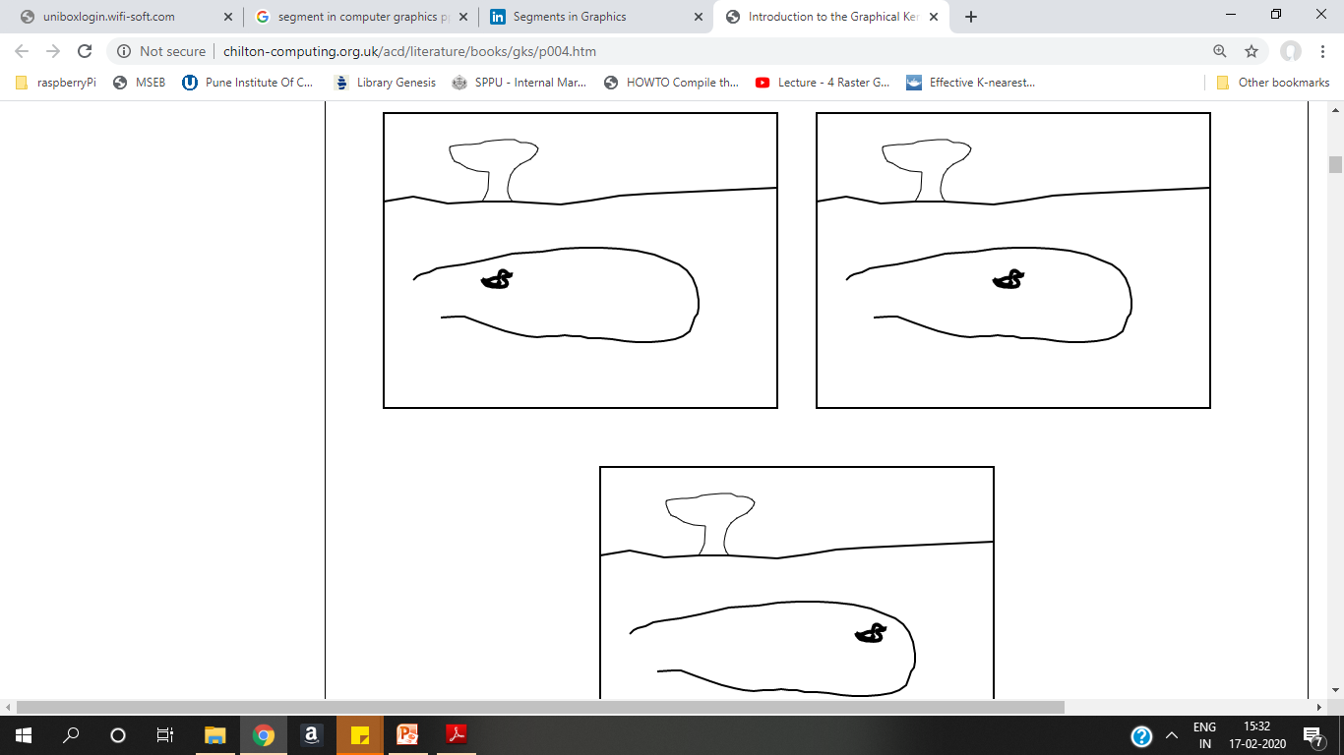

Slide 6
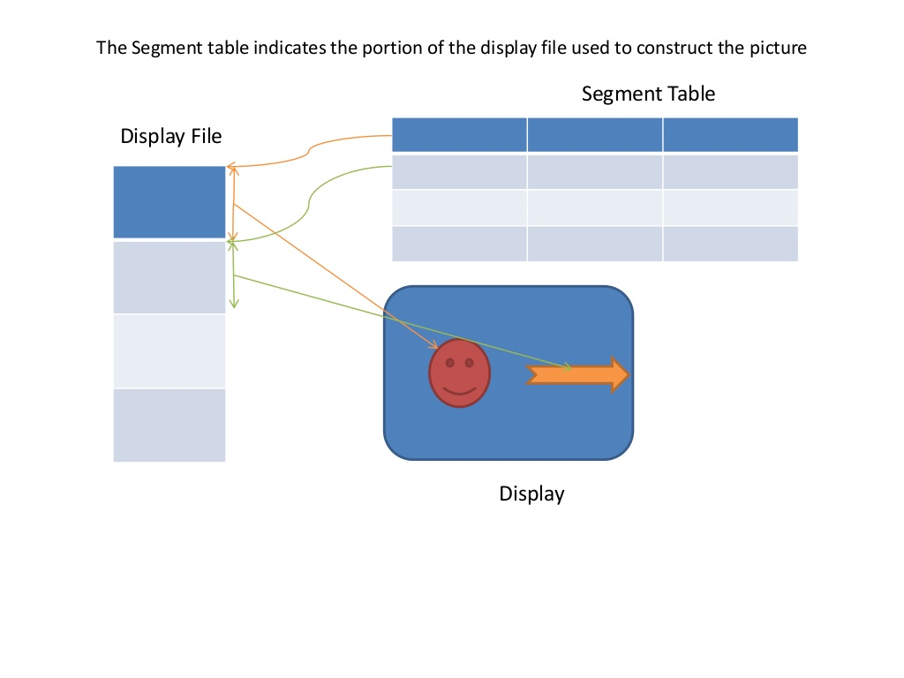

Slide 7
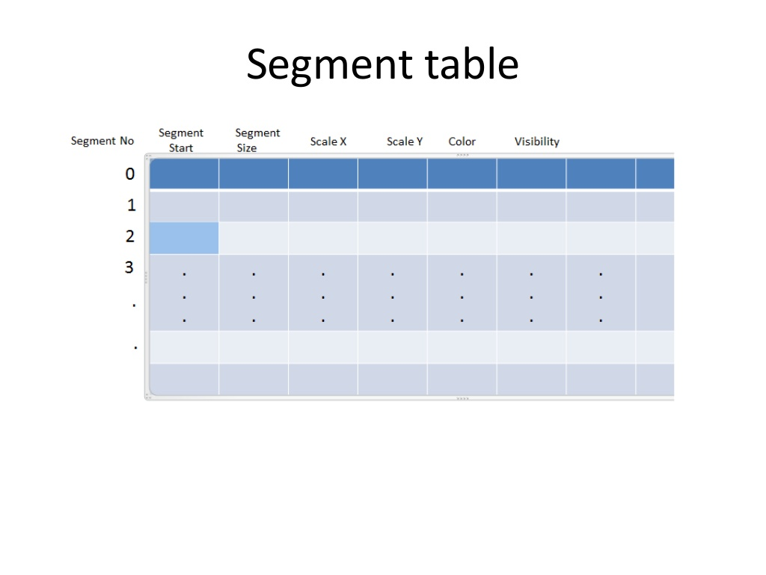

Slide 8
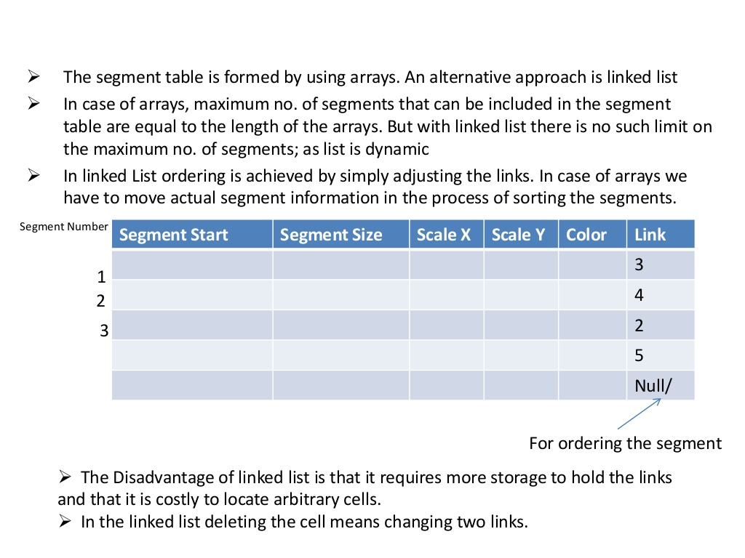

Slide 9
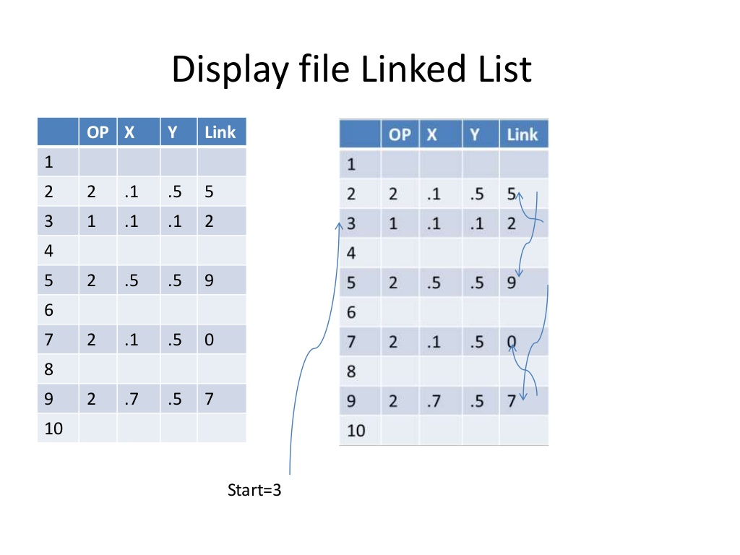

Slide 10
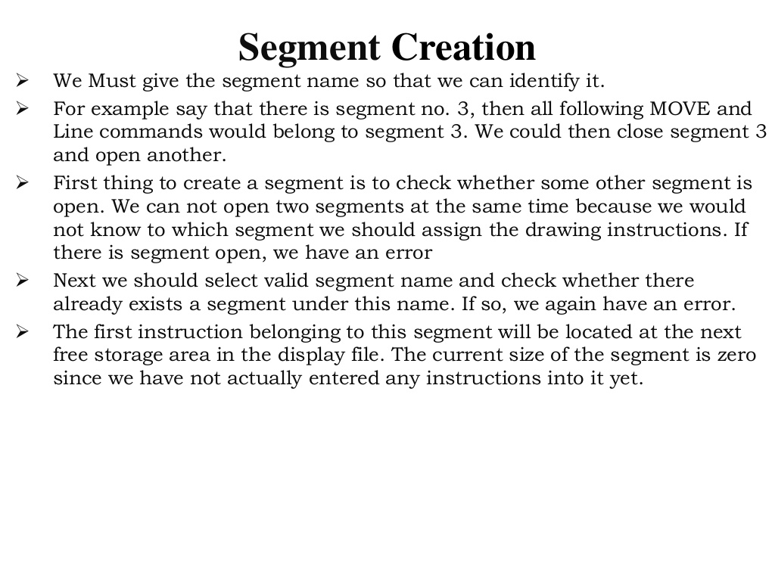

Slide 11
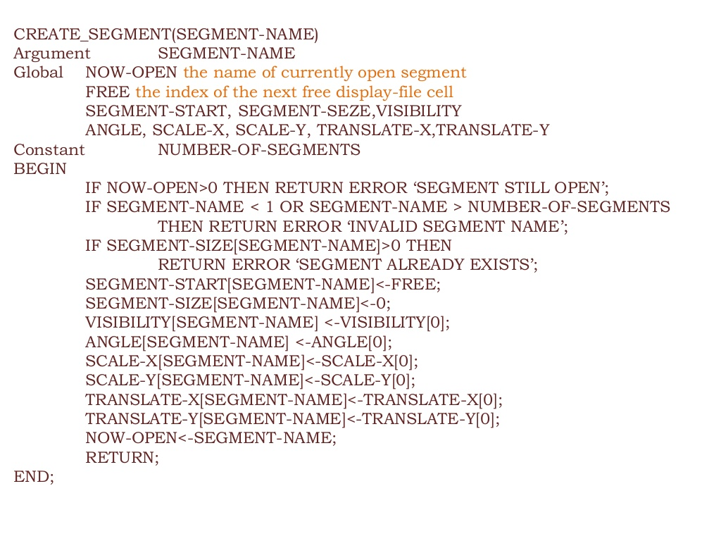

Slide 12
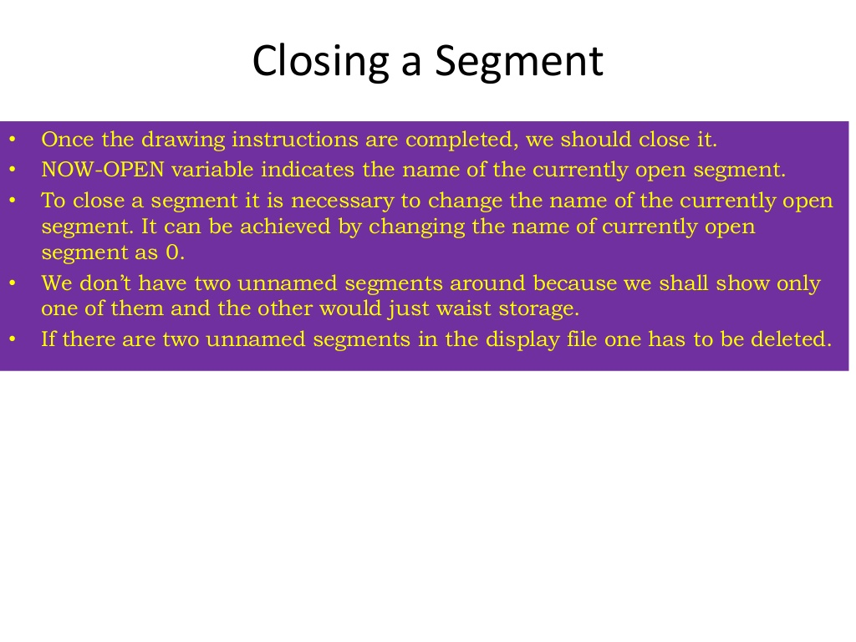

Slide 13
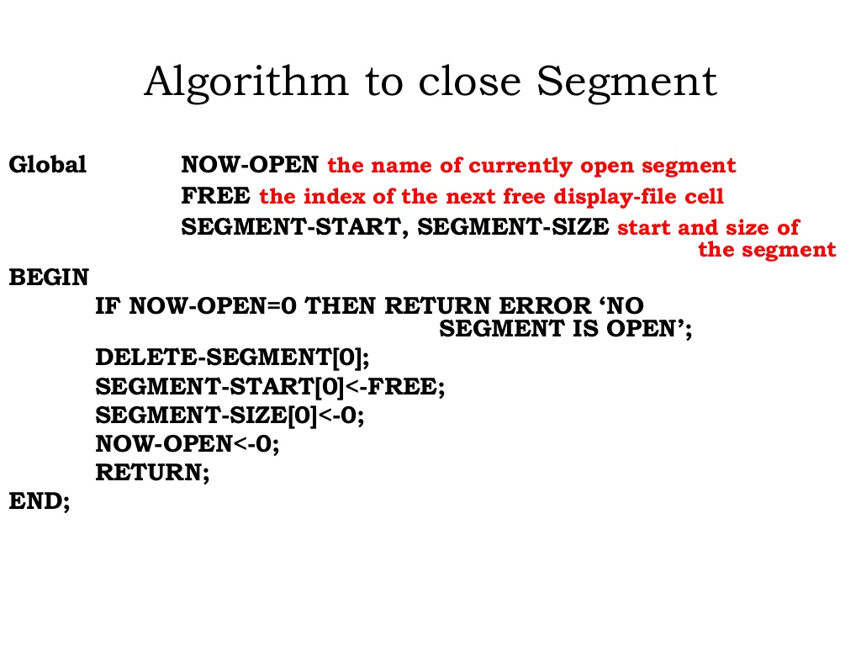

Slide 14
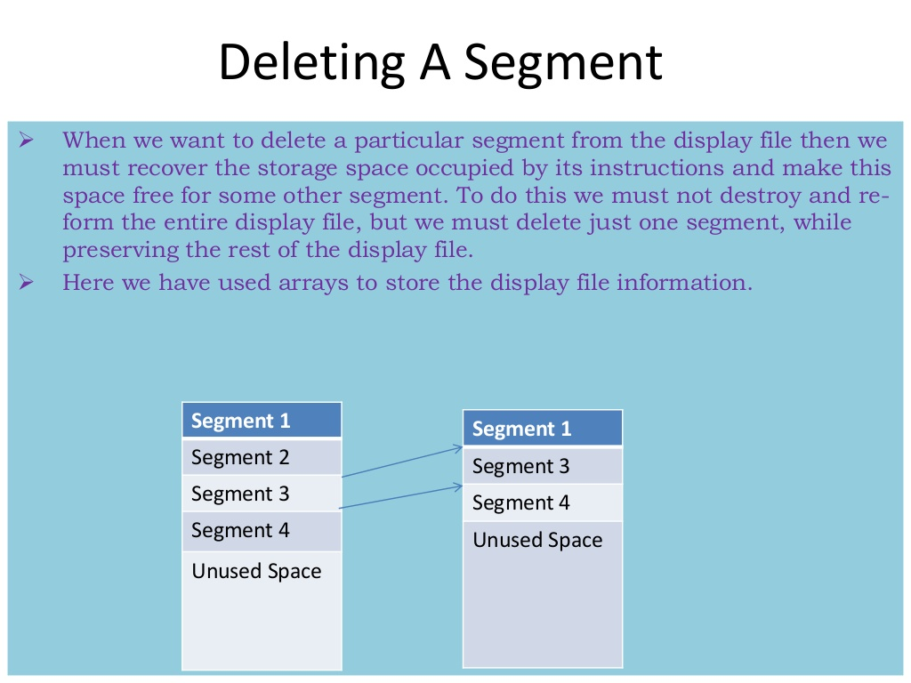

Slide 15
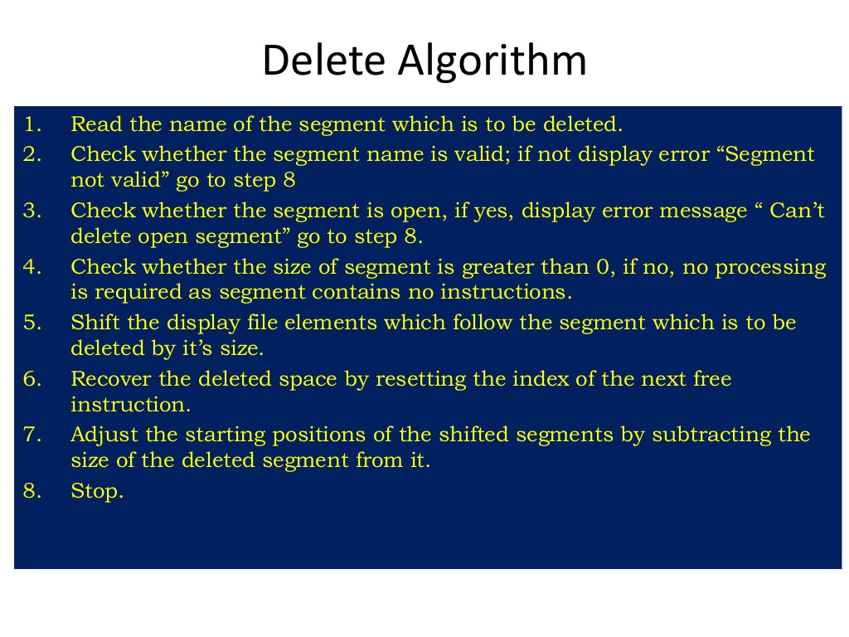

Slide 16
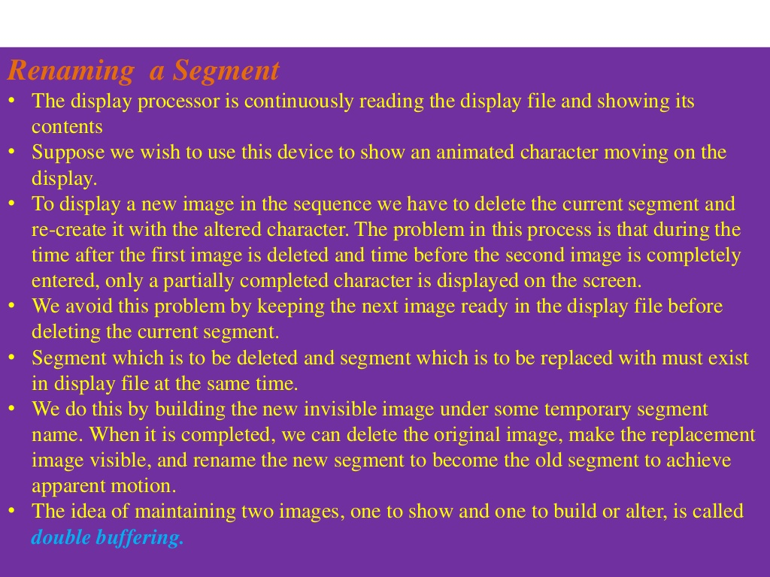

Slide 17
